Slide 1




Dictionaries, Hash Tables and Sets
Dictionaries, Hash Tables, Hashing, Collisions, Sets
Hash Tables
SoftUni Team
Technical Trainers
Software University
http://softuni.bg

Slide 2

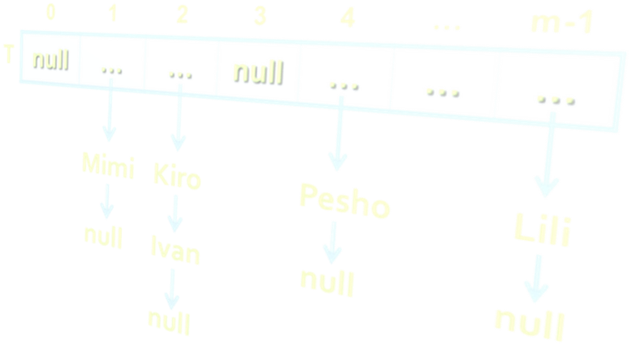
Table of Contents
Dictionary (Map) Abstract Data Type
Hash Tables, Hashing and Collision Resolution
Dictionary<TKey, TValue> Class
Sets: HashSet<T> and SortedSet<T>

Slide 3
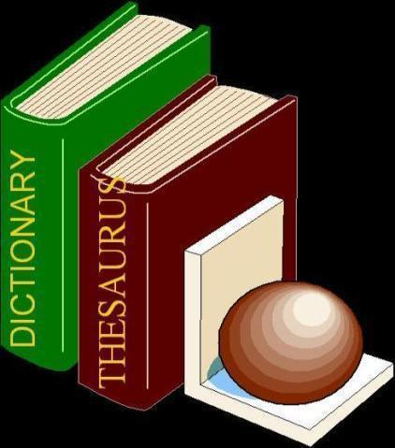

Dictionaries
Data Structures that Map Keys to Values

Slide 4
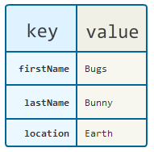
The Dictionary (Map) ADT
The abstract data type (ADT) "dictionary" maps key to values
Also known as "map" or "associative array"
Holds a set of {key, value} pairs
Dictionary ADT operations:
Add(key, value)
FindByKey(key) → value
Delete(key)
Many implementations
Hash table, balanced tree, list, array, ...

Slide 5
ADT Dictionary – Example
Sample dictionary:
Key | Value
C# | Modern general-purpose object-oriented programming language for the Microsoft .NET platform
PHP | Popular server-side scripting language for Web development
compiler | Software that transforms a computer program to executable machine code
… | …

Slide 6
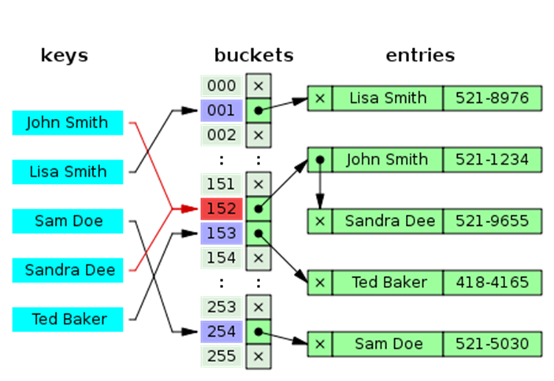
Hash Tables
What is Hash Table? How it Works?

Slide 7
Hash Table
A hash table is an array that holds a set of {key, value} pairs
The process of mapping a key to a position in a table is called hashing
0 | 1 | 2 | 3 | 4 | 5 | … | m-1
T
… | … | … | … | … | … | … | …
Hash function h: k → 0 … m-1
h(k)
Hash table of size m

Slide 8
Hash Functions and Hashing
A hash table has m slots, indexed from 0 to m-1
A hash function h(k) maps the keys to positions:
h: k → 0 … m-1
For arbitrary value k in the key range and some hash function h we have h(k) = p and 0 ≤ p < m
0 | 1 | 2 | 3 | 4 | 5 | … | m-1
T
… | … | … | … | … | … | … | …
h(k)

Slide 9
Hashing Functions
Perfect hashing function (PHF)
h(k): one-to-one mapping of each key k to an integer in the range [0, m-1]
The PHF maps each key to a distinct integer within some manageable range
Finding a perfect hashing function is impossible in most cases
More realistically
Hash function h(k) that maps most of the keys onto unique integers, but not all

Slide 10

Collisions in a Hash Table
A collision comes when different keys have the same hash value
h(k₁) = h(k₂) for k₁ ≠ k₂
When the number of collisions is sufficiently small, the hash tables work quite well (fast)
Several collisions resolution strategies exist
Chaining collided keys (+ values) in a list
Re-hashing (second hash function)
Using the neighbor slots (linear probing)
Many other

Slide 11

Collision Resolution: Chaining
h("Pesho") = 4
h("Kiro") = 2
h("Mimi") = 1
h("Ivan") = 2
h("Lili") = m-1
Chaining the elements in case of collision
collision
0 | 1 | 2 | 3 | 4 | … | m-1
T
null | Mimi | Kiro | null | Pesho | … | Lili
null
Ivan
null
null
null

Slide 12
Collision Resolution: Open Addressing
Open addressing as collision resolution strategy means to take another slot in the hash-table in case of collision, e.g.
Linear probing: take the next empty slot just after the collision
h(key, i) = h(key) + i
where i is the attempt number: 0, 1, 2, …
Quadratic probing: the i^{th} next slot is calculated by a quadratic polynomial (c₁ and c₂ are some constants)
h(key, i) = h(key) + c₁*i + c₂*i²
Re-hashing: use separate (second) hash-function for collisions
h(key, i) = h₁(key) + i*h₂(key)

Slide 13
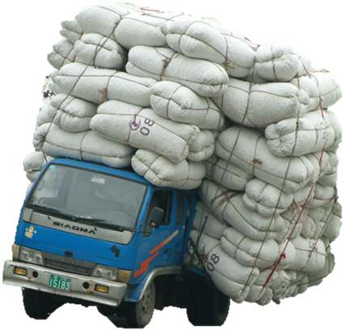
How Big the Hash-Table Should Be?
The load factor (fill factor) = used cells / all cells
How much the hash table is filled, e.g. 65%
Smaller fill factor leads to:
Less collisions (faster average seek time)
More memory consumption
Recommended fill factors:
When chaining is used as collision resolution → less than 75%
When open addressing is used → less than 50%

Slide 14
Adding Item to Hash Table With Chaining
Add("Tanio")
hash("Tanio") % m = 3
map[3] == null?
yes
Initiliaze
linked list
Fill factor >= 75%?
no
yes
Insert("Tanio")
0 | 1 | 2 | 3 | 4 | … | m-1
Resize & rehash
T
null | Mimi | Kiro | null | null | … | Lili
Ivan
null
null
null

Slide 15

Lab Exercise
Implement a Hash-Table with Chaining as Collision Resolution

Slide 16
Implementing a Good Hash Function
The hash-table performance depends on the probability of collisions
Less collisions → faster add / find / delete operations
How to implement a good (efficient) hash function?
A good hash-function should distribute the input values uniformly
The hash code calculation process should be fast
Integer n → use n as hash value (n % size as hash-table slot)
Real number r → use the bitwise representation of r
String s → use a formula over the Unicode representation of s

Slide 17
Built-In Hash Functions in C# / Java
All C# / Java objects already have GetHashCode() method
Primitive types like int, long, float, double, decimal, …
Built-in types like: string, DateTime and Guid
int c, hash1 = (5381<<16) + 5381; int hash2 = hash1;
char *s = src;
while ((c = s[0]) != 0) {
hash1 = ((hash1 << 5) + hash1) ^ c;
c = s[1];
if (c == 0)
break;
hash2 = ((hash2 << 5) + hash2) ^ c;
s += 2;
}
return hash1 + (hash2 * 1566083941);
Hash function for System.String

Slide 18
Hash Functions on Composite Keys
What if we have a composite key
E.g. FirstName + MiddleName + LastName?
Convert keys to string and get its hash code:
Use a custom hash-code function:
var key = string.Format("{0}-{1}-{2}", FirstName, MiddleName, LastName);
var hashCode = (this.FirstName != null ? this.FirstName.GetHashCode() : 0);
hashCode = (hashCode * 397) ^ (this.MiddleName != null ?
this.MiddleName.GetHashCode() : 0);
hashCode = (hashCode * 397) ^ (this.LastName != null ?
this.LastName.GetHashCode() : 0);
return hashCode;

Slide 19
Hash Tables and Efficiency
Hash table efficiency depends on:
Efficient hash-functions
Most implementations use the built-in hash-functions in C# / Java
Collisions should be as low as possible
Fill factor (used buckets / all buckets)
Typically 70% fill → resize and rehash
Avoid frequent resizing! Define the hash table capacity in advance
Collisions resolution algorithm
Most implementations use chaining with linked list

Slide 20
Hash Tables and Efficiency
Hash tables are the most efficient dictionary implementation
Add / Find / Delete take just few primitive operations
Speed does not depend on the size of the hash-table
Amortized complexity O(1) – constant time
Example:
Finding an element in a hash-table holding 1 000 000 elements takes average just 1-2 steps
Finding an element in an array holding 1 000 000 elements takes average 500 000 steps

Slide 21
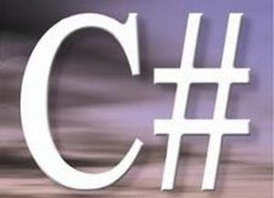
Hash Tables in C#
The Dictionary<TKey,TValue> Class

Slide 22
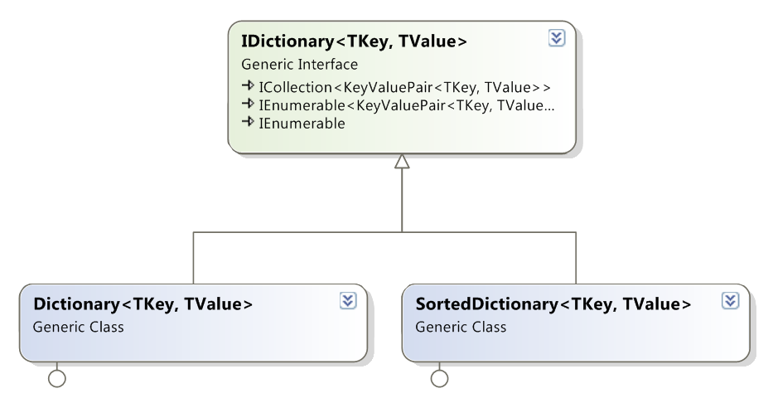
Dictionaries: .NET Interfaces and Classes

Slide 23
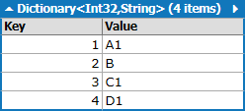
Dictionary<TKey,TValue>
Implements the ADT dictionary as hash table
The size is dynamically increased as needed
Contains a collection of key-value pairs
Collisions are resolved by chaining
Elements have almost random order
Ordered by the hash code of the key
Dictionary<TKey,TValue> relies on:
Object.Equals() – compares the keys
Object.GetHashCode() – calculates the hash codes of the keys

Slide 24
Dictionary<TKey,TValue> (2)
Exception when the key already exists
Major operations:
Add(key, value) – adds an element by key + value
Remove(key) – removes a value by key
this[key] = value – add / replace element by key
this[key] – gets an element by key
Clear() – removes all elements
Count – returns the number of elements
Keys – returns a collection of all keys (in unspecified order)
Values – returns a collection of all values (in unspecified order)
Returns true / false
Exception on non-existing key

Slide 25
Dictionary<TKey,TValue> (3)
Major operations:
ContainsKey(key) – checks if given key exists in the dictionary
ContainsValue(value) – checks whether the dictionary contains given value
Warning: slow operation – O(n)
TryGetValue(key, out value)
If the key is found, returns it in the value parameter
Otherwise returns false

Slide 26

Dictionary<TKey,TValue> – Example
var studentGrades = new Dictionary<string, int>();
studentGrades.Add("Ivan", 4);
studentGrades.Add("Peter", 6);
studentGrades.Add("Maria", 6);
studentGrades.Add("George", 5);
int peterGrade = studentGrades["Peter"];
Console.WriteLine("Peter's grade: {0}", peterGrade);
Console.WriteLine("Is Peter in the hash table: {0}",
studentsGrades.ContainsKey("Peter"));
Console.WriteLine("Students and their grades:");
foreach (var pair in studentsGrades)
{
Console.WriteLine("{0} --> {1}", pair.Key, pair.Value);
}

Slide 27


Dictionary<TKey,TValue>
Live Demo

Slide 28

Counting the Words in a Text
string text = "a text, some text, just some text";
var wordsCount = new Dictionary<string, int>();
string[] words = text.Split(' ', ',', '.');
foreach (string word in words)
{
int count = 1;
if (wordsCount.ContainsKey(word))
count = wordsCount[word] + 1;
wordsCount[word] = count;
}
foreach(var pair in wordsCount)
{
Console.WriteLine("{0} -> {1}", pair.Key, pair.Value);
}

Slide 29

Counting the Words in a Text
Live Demo

Slide 30
Nested Data Structures
Data structures can be nested, e.g. dictionary of lists: Dictionary<string, List<int>>
static Dictionary<string, List<int>> studentGrades =
new Dictionary<string, List<int>>();
private static void AddGrade(string name, int grade)
{
if (! studentGrades.ContainsKey(name))
{
studentGrades[name] = new List<int>();
}
studentGrades[name].Add(grade);
}

Slide 31
Nested Data Structures (2)
var countriesAndCities =
new Dictionary<string, Dictionary<string, int>>();
countriesAndCities["Bulgaria"] = new Dictionary<string, int>());
countriesAndCities["Bulgaria"]["Sofia"] = 1000000;
countriesAndCities["Bulgaria"]["Plovdiv"] = 400000;
countriesAndCities["Bulgaria"]["Pernik"] = 30000;
foreach (var city in countriesAndCities["Bulgaria"])
{
Console.WriteLine("{0} : {1}", city.Key, city.Value);
}
var totalPopulation = countriesAndCities["Bulgaria"]
.Sum(c => c.Value);
Console.WriteLine(totalPopulation);

Slide 32
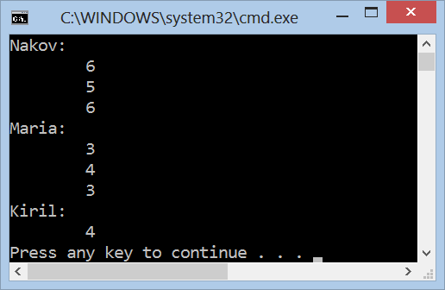
Dictionary of Lists
Live Demo

Slide 33
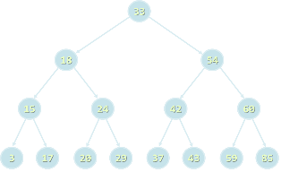

Balanced Tree-Based Dictionaries
The SortedDictionary<TKey,TValue> Class

Slide 34
SortedDictionary<TKey,TValue>
SortedDictionary<TKey,TValue> implements the ADT "dictionary" as self-balancing search tree
Elements are arranged in the tree ordered by key
Traversing the tree returns the elements in increasing order
Add / Find / Delete perform log₂(n) operations
Use SortedDictionary<TKey,TValue> when you need the elements sorted by key
Otherwise use Dictionary<TKey,TValue> – it has better performance

Slide 35
Counting Words (Again)
string text = "a text, some text, just some text";
IDictionary<string, int> wordsCount =
new SortedDictionary<string, int>();
string[] words = text.Split(' ', ',', '.');
foreach (string word in words)
{
int count = 1;
if (wordsCount.ContainsKey(word))
count = wordsCount[word] + 1;
wordsCount[word] = count;
}
foreach(var pair in wordsCount)
{
Console.WriteLine("{0} -> {1}", pair.Key, pair.Value);
}

Slide 36
Counting the Words in a Text
Live Demo

Slide 37

Comparing Dictionary Keys
Using Custom Key Classes in Dictionary<TKey, TValue> and SortedDictionary<TKey,TValue>

Slide 38
IComparable<T>
Dictionary<TKey,TValue> relies on
Object.Equals() – for comparing the keys
Object.GetHashCode() – for calculating the hash codes of the keys
SortedDictionary<TKey,TValue> relies on IComparable<T> for ordering the keys
Built-in types like int, long, float, string and DateTime already implement Equals(), GetHashCode() and IComparable<T>
Other types used when used as dictionary keys should provide custom implementations

Slide 39


Implementing Equals() and GetHashCode()
public struct Point
{
public int X { get; set; }
public int Y { get; set; }
public override bool Equals(Object obj)
{
if (!(obj is Point) || (obj == null)) return false;
Point p = (Point)obj;
return (X == p.X) && (Y == p.Y);
}
public override int GetHashCode()
{
return (X << 16 | X >> 16) ^ Y;
}
}

Slide 40



Implementing IComparable<T>
public struct Point : IComparable<Point>
{
public int X { get; set; }
public int Y { get; set; }
public int CompareTo(Point otherPoint)
{
if (X != otherPoint.X)
{
return this.X.CompareTo(otherPoint.X);
}
else
{
return this.Y.CompareTo(otherPoint.Y);
}
}
}

Slide 41

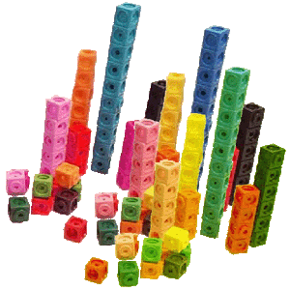
Sets
Sets of Elements

Slide 42
Set and Bag ADTs
The abstract data type (ADT) "set" keeps a set of elements with no duplicates
Sets with duplicates are also known as ADT "bag"
Set operations:
Add(element)
Contains(element) → true / false
Delete(element)
Union(set) / Intersect(set)
Sets can be implemented in several ways
List, array, hash table, balanced tree, ...

Slide 43
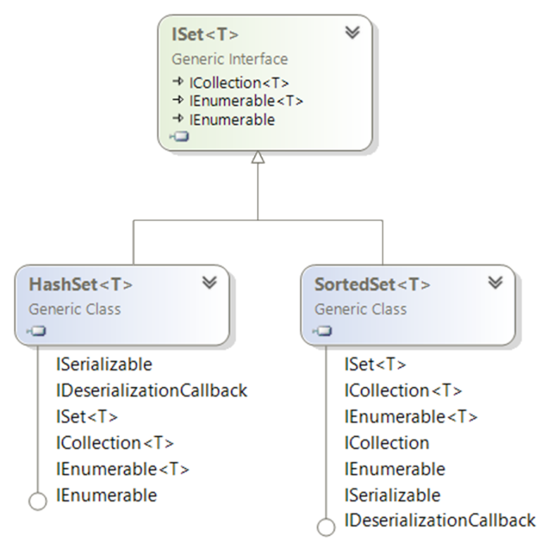
Sets: .NET Interfaces and Implementations

Slide 44
HashSet<T>
HashSet<T> implements ADT set by hash table
Elements are in no particular order
All major operations are fast:
Add(element) – appends an element to the set
Does nothing if the element already exists
Remove(element) – removes given element
Count – returns the number of elements
UnionWith(set) / IntersectWith(set) – performs union / intersection with another set

Slide 45

HashSet<T> – Example
ISet<string> firstSet = new HashSet<string>(
new string[] { "SQL", "Java", "C#", "PHP" });
ISet<string> secondSet = new HashSet<string>(
new string[] { "Oracle", "SQL", "MySQL" });
ISet<string> union = new HashSet<string>(firstSet);
union.UnionWith(secondSet);
foreach (var element in union)
{
Console.Write("{0} ", element);
}
Console.WriteLine();

Slide 46
SortedSet<T>
SortedSet<T> implements ADT set by balanced search tree (red-black tree)
Elements are sorted in increasing order
Example:
ISet<string> firstSet = new SortedSet<string>(
new string[] { "SQL", "Java", "C#", "PHP" });
ISet<string> secondSet = new SortedSet<string>(
new string[] { "Oracle", "SQL", "MySQL" });
ISet<string> union = new HashSet<string>(firstSet);
union.UnionWith(secondSet);
PrintSet(union); // C# Java PHP SQL MySQL Oracle

Slide 47


HashSet<T> and SortedSet<T>
Live Demo

Slide 48
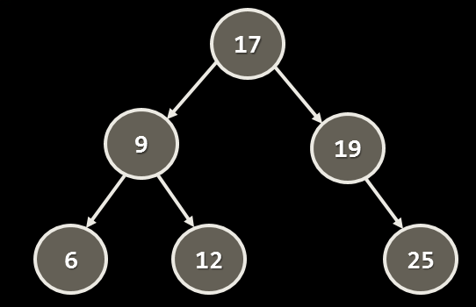
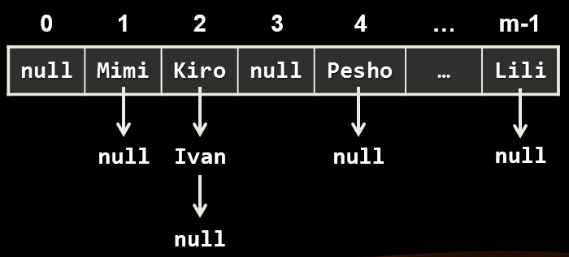
Dictionaries and Sets Comparison
Data Structure | Internal Structure | Time Compexity (Add/Update/Delete)
Dictionary<K,V> HashSet<K> |  | O(1)
SortedDictionary<K,V> SortedSet<K> |  | O(log(n))

Slide 49

Summary
Dictionaries map key to value
Can be implemented as hash table or balanced search tree
Hash-tables map keys to values
Rely on hash-functions to distribute the keys in the table
Collisions needs resolution algorithm (e.g. chaining)
Very fast add / find / delete – O(1)
Sets hold a group of elements
Hash-table or balanced tree implementations

Slide 50









Dictionaries, Hash Tables and Sets
https://softuni.bg/courses/data-structures/

Slide 51
License
This course (slides, examples, labs, videos, homework, etc.) is licensed under the "Creative Commons Attribution-NonCommercial-ShareAlike 4.0 International" license
Attribution: this work may contain portions from
"Fundamentals of Computer Programming with C#" book by Svetlin Nakov & Co. under CC-BY-SA license
"Data Structures and Algorithms" course by Telerik Academy under CC-BY-NC-SA license

Slide 52






Free Trainings @ Software University
Software University Foundation – softuni.org
Software University – High-Quality Education, Profession and Job for Software Developers
softuni.bg
Software University @ Facebook
facebook.com/SoftwareUniversity
Software University @ YouTube
youtube.com/SoftwareUniversity
Software University Forums – forum.softuni.bg

